Slide 1



GIT ASSIGNMENT
Presented By : Sandeep Chakraborty
E-mail: Sandeep.Chakraborty@knoldus.com

Slide 2
AGENDA
Introduction to GIT
What is GitHub?
Git Cheat Sheet
Creating Empty Repository
Basic Git workflow
How to push local repo content to remote repository?
GIT Worktree
GitHub link
Conclusion

Slide 3
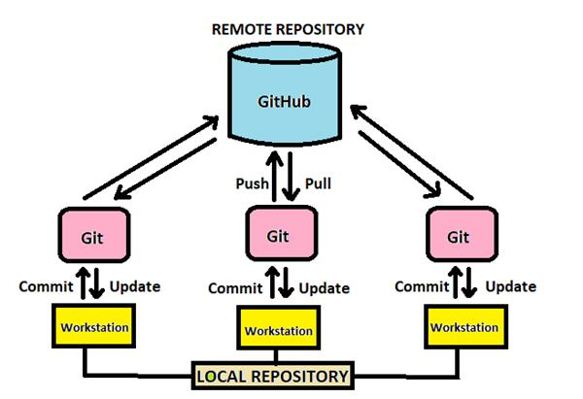
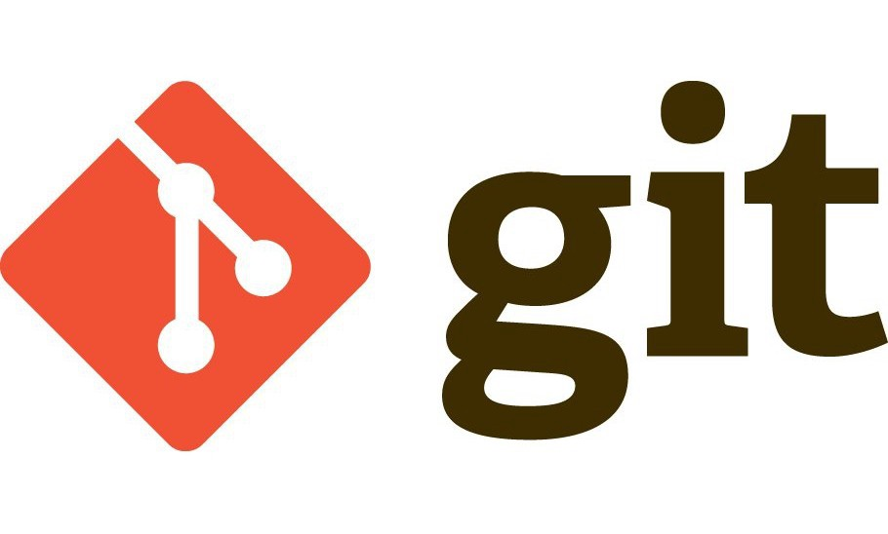
WHAT IS GIT ?
Git is a mature, actively maintained open source project originally developed in 2005 by Linus Torvalds, the famous creator of the Linux operating system kernel.
By far, the most widely used modern version control system in the world today is Git.
Git is a free and open source distributed version control system designed to handle everything from small to very large projects with speed and efficiency.
Summing up, Git is software for tracking changes in any set of files, usually used for coordinating work among programmers collaboratively developing source code during software development. Its goals include speed, data integrity, and support for distributed, non-linear workflows.

Slide 4

What is GitHub?
What is GitHub?
GitHub Inc. is a provider of Internet hosting for software development and version control using Git. It offers the distributed version control and source code management functionality of Git, plus its own features.
GitHub is a code hosting platform for collaboration and version control.
GitHub essentials are:
Repositories
Branches
Commits
Pull Requests
Git (the version control software GitHub is built on)

Slide 5
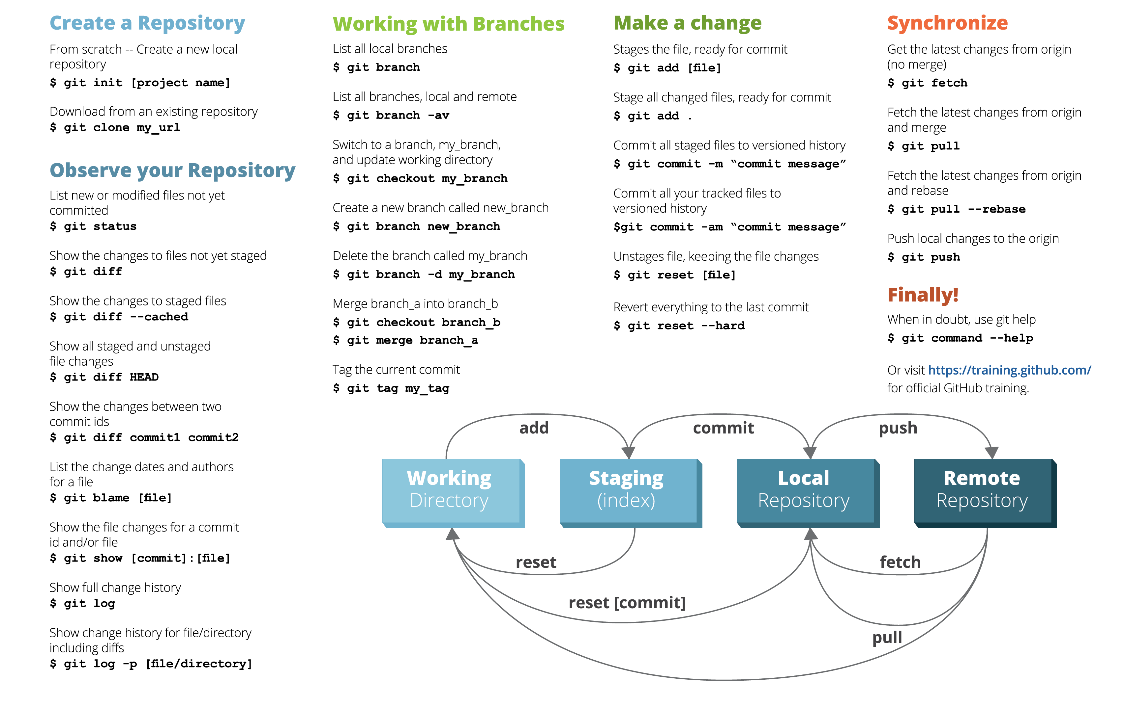
GIT Cheat Sheet

Slide 6
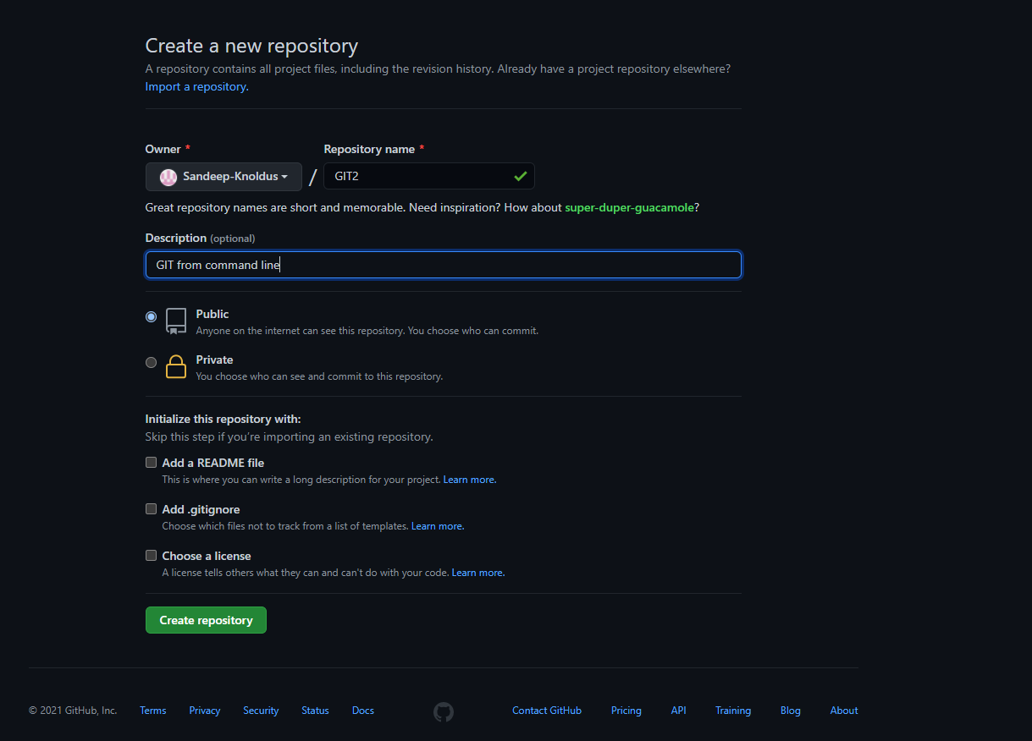
CREATING AN EMPTY REPOSITORY ON GITHUB

Slide 7
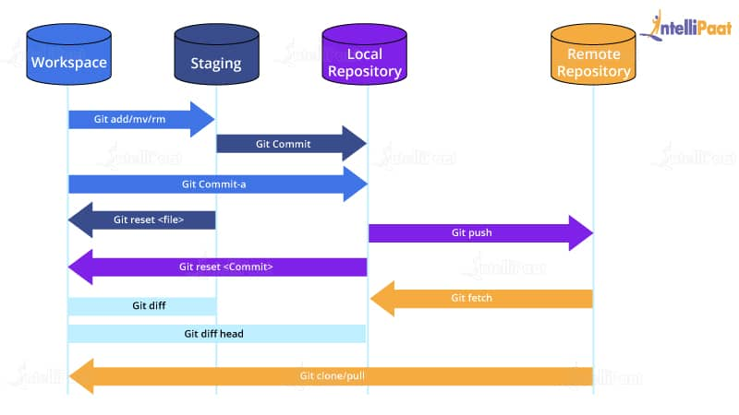
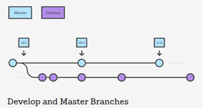

BASIC GIT WORKFLOW
A Git workflow is a recipe or recommendation for how to use Git to accomplish work in a consistent and productive manner. Git workflows encourage developers and DevOps teams to leverage Git effectively and consistently. Git offers a lot of flexibility in how users manage changes.

Slide 8
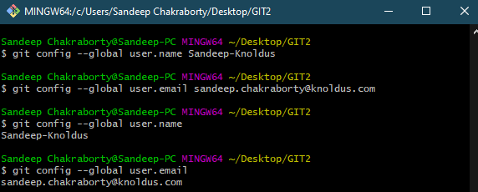

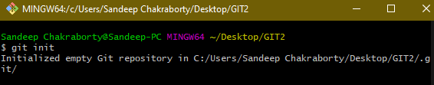

HOW TO PUSH LOCAL REPO CONTENT TO REMOTE REPOSITORY?
Setting GIT configuration values:
Creating a new GIT repo:

Slide 9
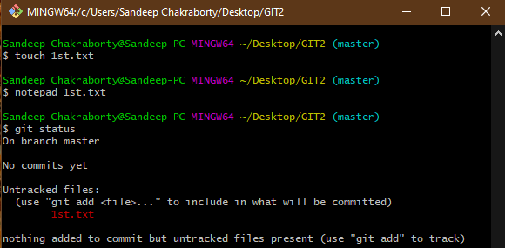
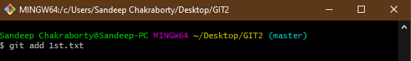
Creating a file, editing it and checking status of the Repo:
Adding a change in the working directory to the staging area:

Slide 10
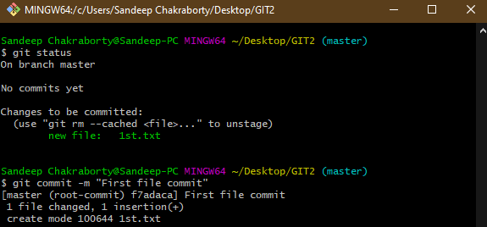
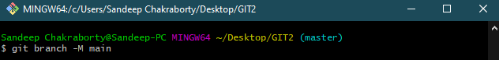
Checking Status of the Repo and save the changes to local repository (commit):
Creating a branch (movable pointer to commits):

Slide 11
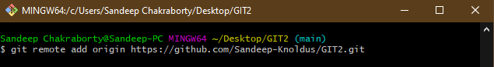
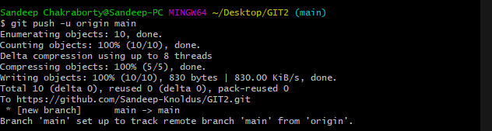
Creating a remote respiratory with GitHub repo link, naming as ‘origin’:
Upload the local repo content to the remote repo (push):

Slide 12
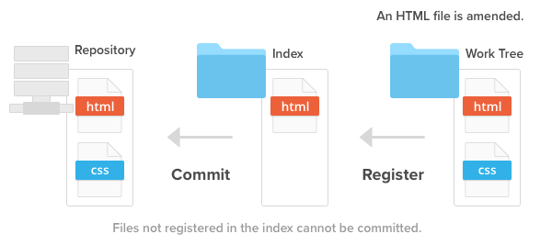
GIT WorkTree
A Git worktree is a linked copy of your Git repository, allowing you to have multiple branches checked out at a time. A worktree has a separate path from your main working copy, but it can be in a different state and on a different branch. The advantage of a new worktree in Git is that you can make a change unrelated to your current task, commit the change, and then merge it at a later date, all without disturbing your current work environment.

Slide 13
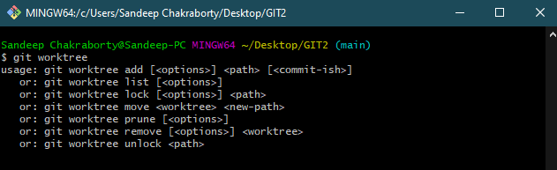
Common use of Worktree
A git repository can support multiple working trees, allowing you to check out more than one branch at a time. With “git worktree add” a new working tree is associated with the repository. This new working tree is called a "linked working tree" as opposed to the "main working tree" prepared by “git-init” or “git-clone”. A repository has one main working tree (if it’s not a bare repository) and zero or more linked working trees. When you are done with a linked working tree, remove it with “git worktree remove”.

Slide 14
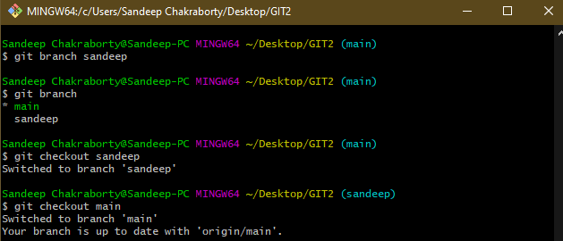
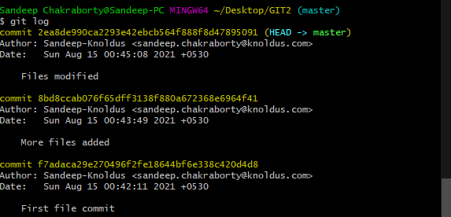
Listing the Branches (git branch), Creating New Branch (git branch <branch_name>) & Switching it (git checkout <existing_branch_name>):
Listing the commits made in the repo in reverse chronological order:

Slide 15
Conclusion
In conclusion, Git provides a way of keeping track of past versions of software and papers, making collaboration between various authors easy, and provides backup for your software. It has proven very useful to the open-source community and in academia as well.

Slide 16
MY GITHUB LINK -
https://github.com/Sandeep-Knoldus/GIT2/

Slide 17

Thank You!

